Slide 1
Data wrangling project
Group 2
Vasatika Ghadiyaram
Hemanshu Dhuria
Siddhant Ambardekar
Mehal Sanghvi

Slide 2
Business objectives
Analysing Social Determinants of Health – Age, Income, Crime w.r.t. Health Insurance
Determine the groups at risk basis social determinants of health (SDOH) that can be targeted for providing insurance.
Understand target audience groups and ideate ways to provide health insurance for vulnerable groups and determine the coverage.
outcome
Final dataset is being developed for the insurance companies to use it in designing their health care plans by studying the selected Social Determinant of Health i.e, Crime across the Age and Income of Massachusetts county level census.

Slide 3



Data Sources
Collection SOURCES and Data Description
Scope of Data
Data Collection and update frequency
SDOH Database Tracks data for five main SDOH domains based on geography.
Crime Database
Crime rates and types of crime based on geography (part of 5 SDOH domains- physical infrastructure)
Scope
Datasets have a wider scope which tracks 683 variables for SDOH and 146 variables for Crime data.
Reliability
Data is sourced from Kaggle and ahrq.gov websites.
Validity
Both data sets have a citations, licenses mentioned in the footer which supplements the validity of data.
SDOH Data - Drawn from multiple sources ( original data documents, codebooks, surveys and environmental scan)
Crime Data - Data collection process unknown.
SDOH Data - Updated yearly
Crime Data - Never Updated (will have to find a new data for succeeding year)

Slide 4
How did we get there?
Data Wrangling Steps – SDOH Data
SDOH DATA
Challenges
Large number of columns in the original dataset to identify the relevant ones.
The data is inconsistent as columns are in both percentages and medians
Large data set which poses a challenge to profile the data (683columns)
Identify the relevant columns
Subset according to the unit of analysis.
Data Formatting
Explored new python libraries for visualization.
Data Profiling to know the summary of the data quality
Merge both the datasets.

Slide 5
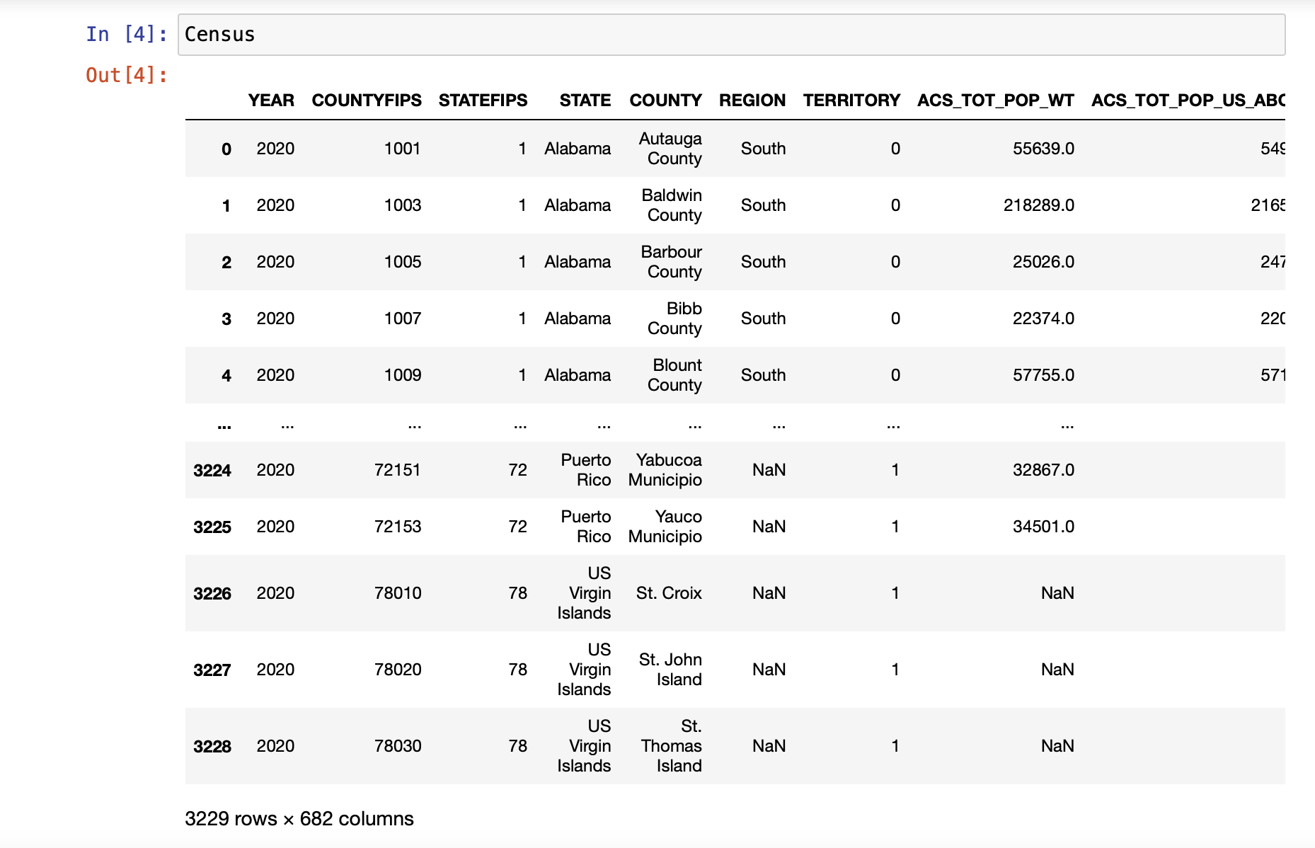
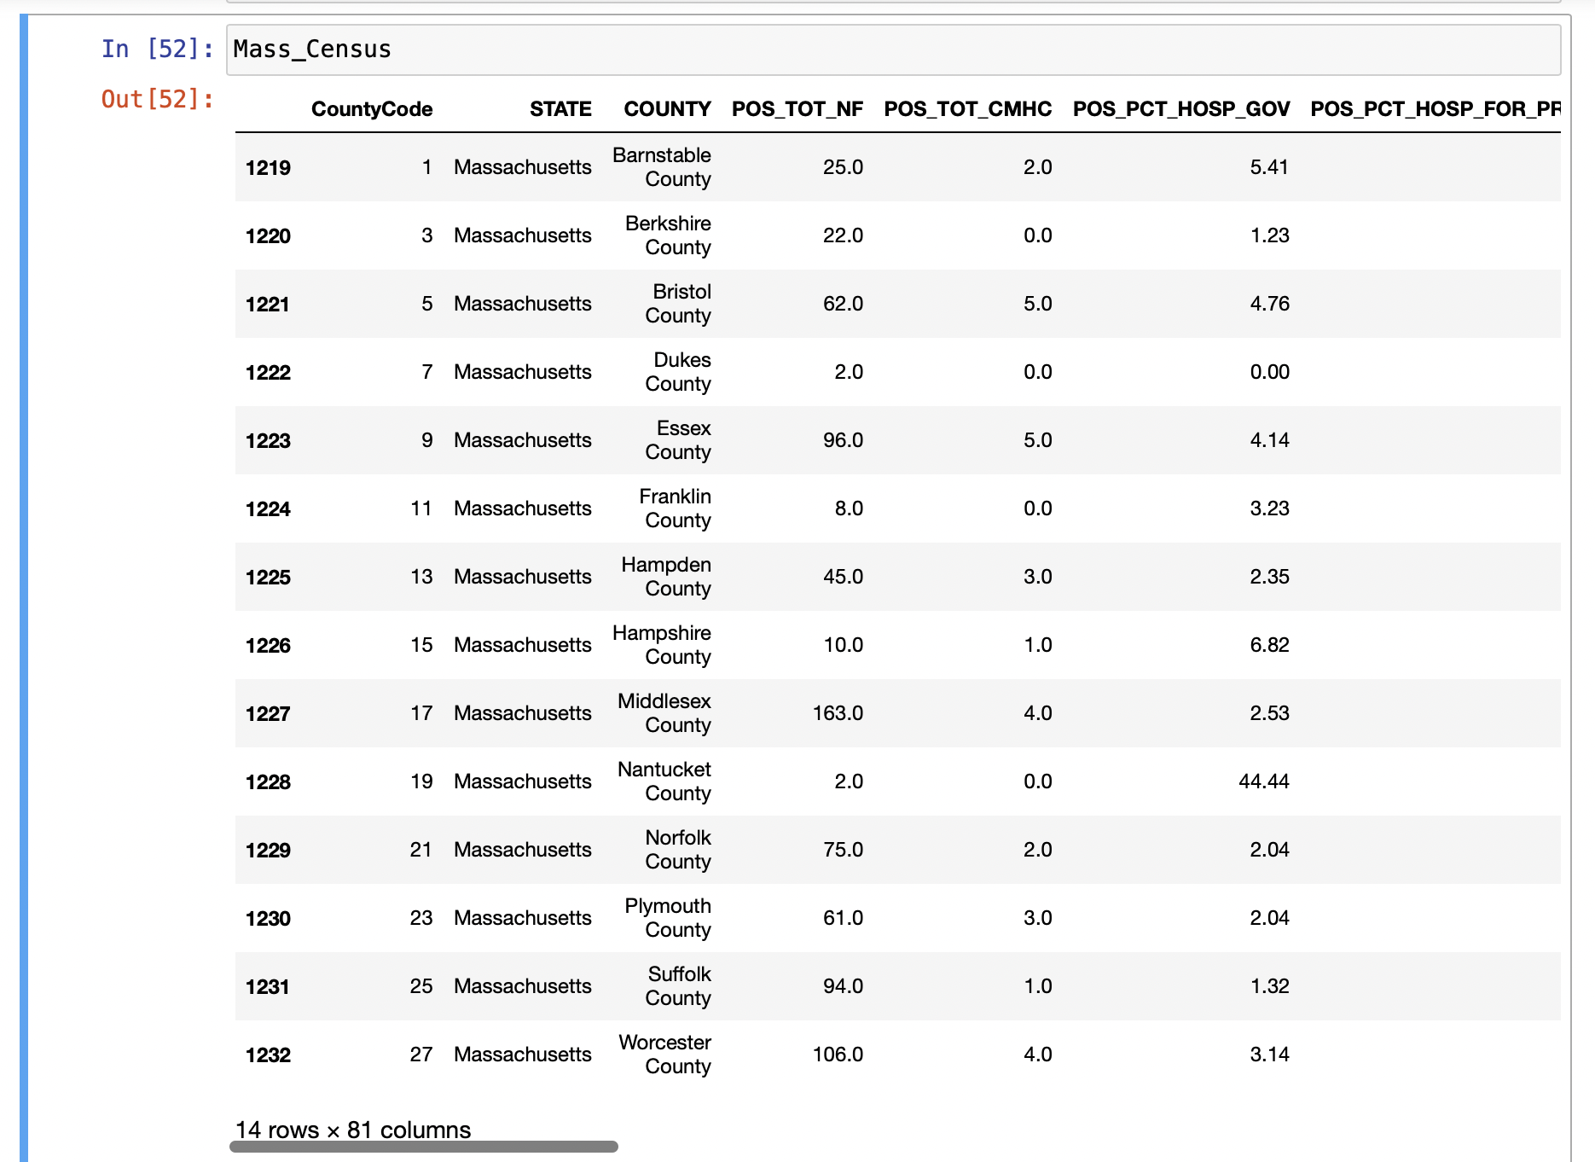
How did we get there?
Data Wrangling Steps – SDOH Data
Before
After

Slide 6
How did we get there?
Data Wrangling Steps – CRIME Data
CRIME DATA
Challenges
Census data lacks the consideration of crime as an effect on SDOH indices. Finding a way to include this data into overall SDOH was the unique process encountered
Column selection according to the variables required in the merged data.
Unique row wise aggregation of county data using different formulas for individual columns.
Correlation between Age groups and Crime types.
Outer Merge of Data using County column.
Analyzing relations between the SDOH indices and Crime
Large data set which poses a challenge to profile the data (146 columns)
Missing data for 2 counties made it difficult to merge.
Ensuring the final data was consistent and clean was a time taking process

Slide 7
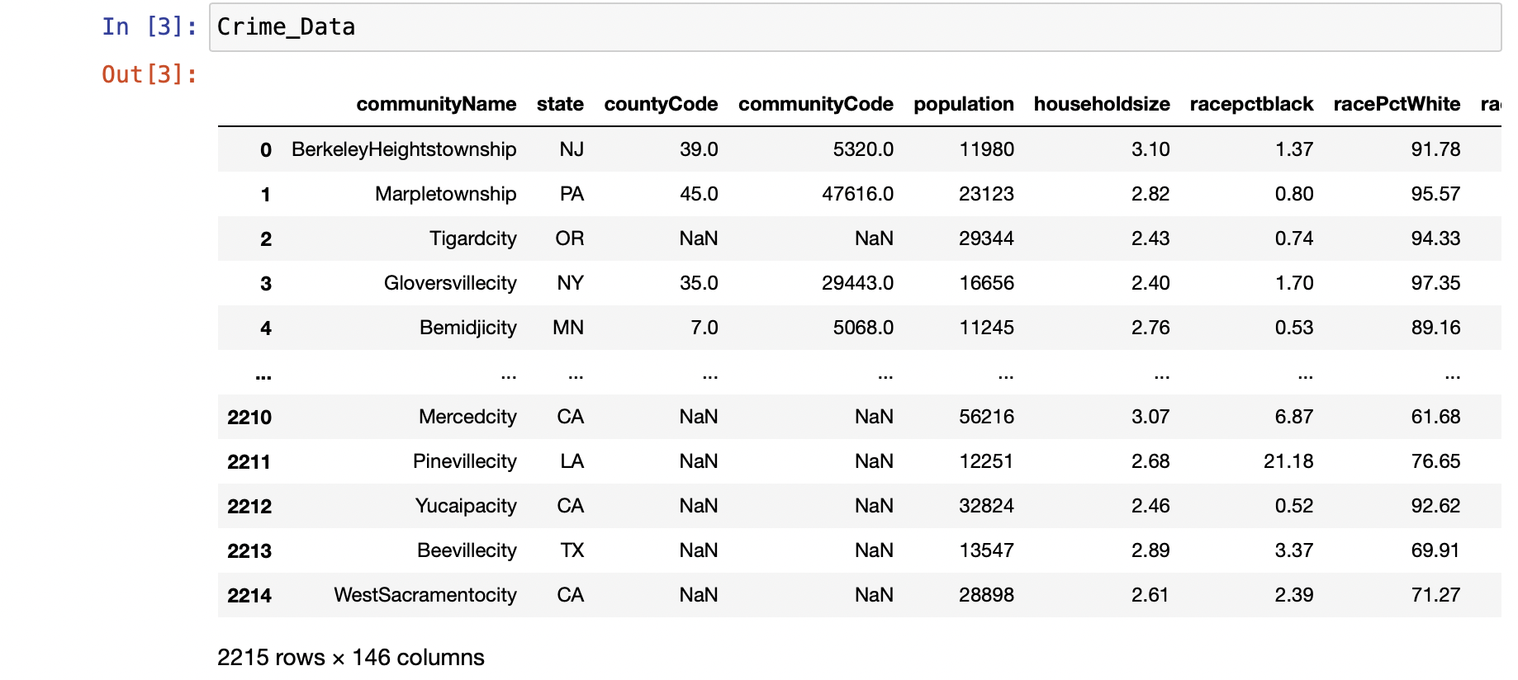
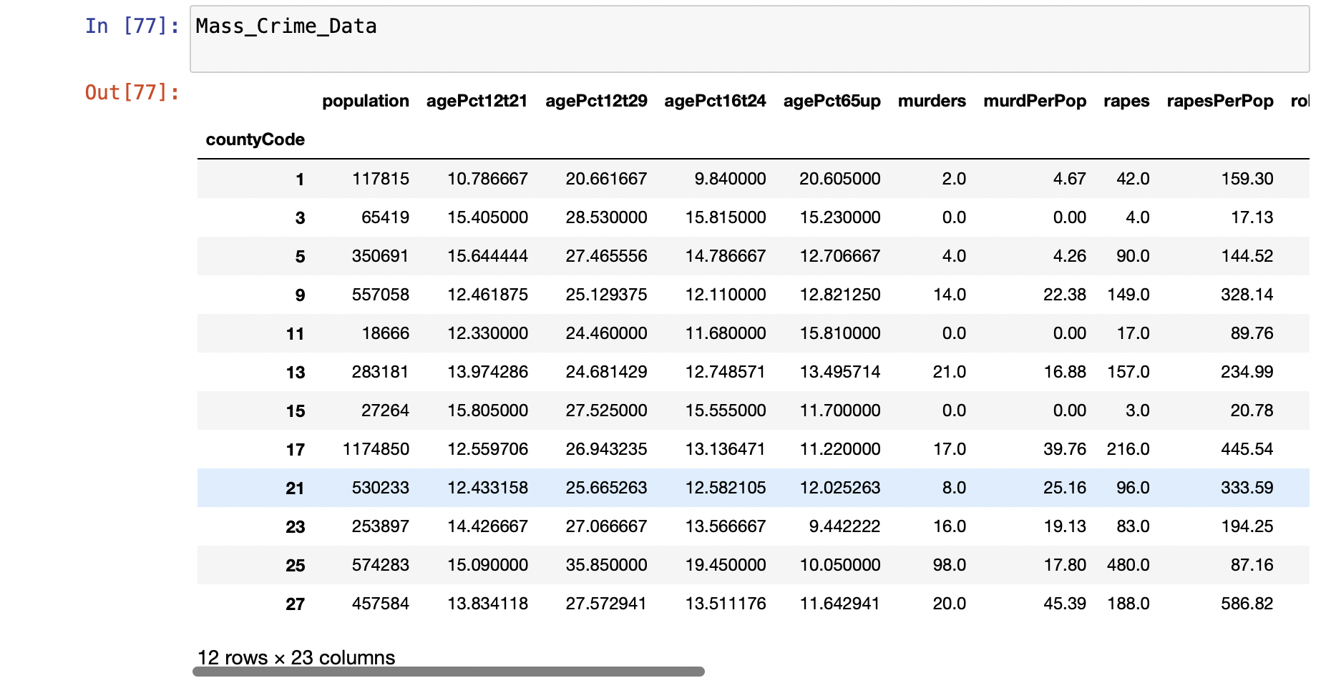
How did we get there?
Data Wrangling Steps – CRIME Data
Before
After

Slide 8
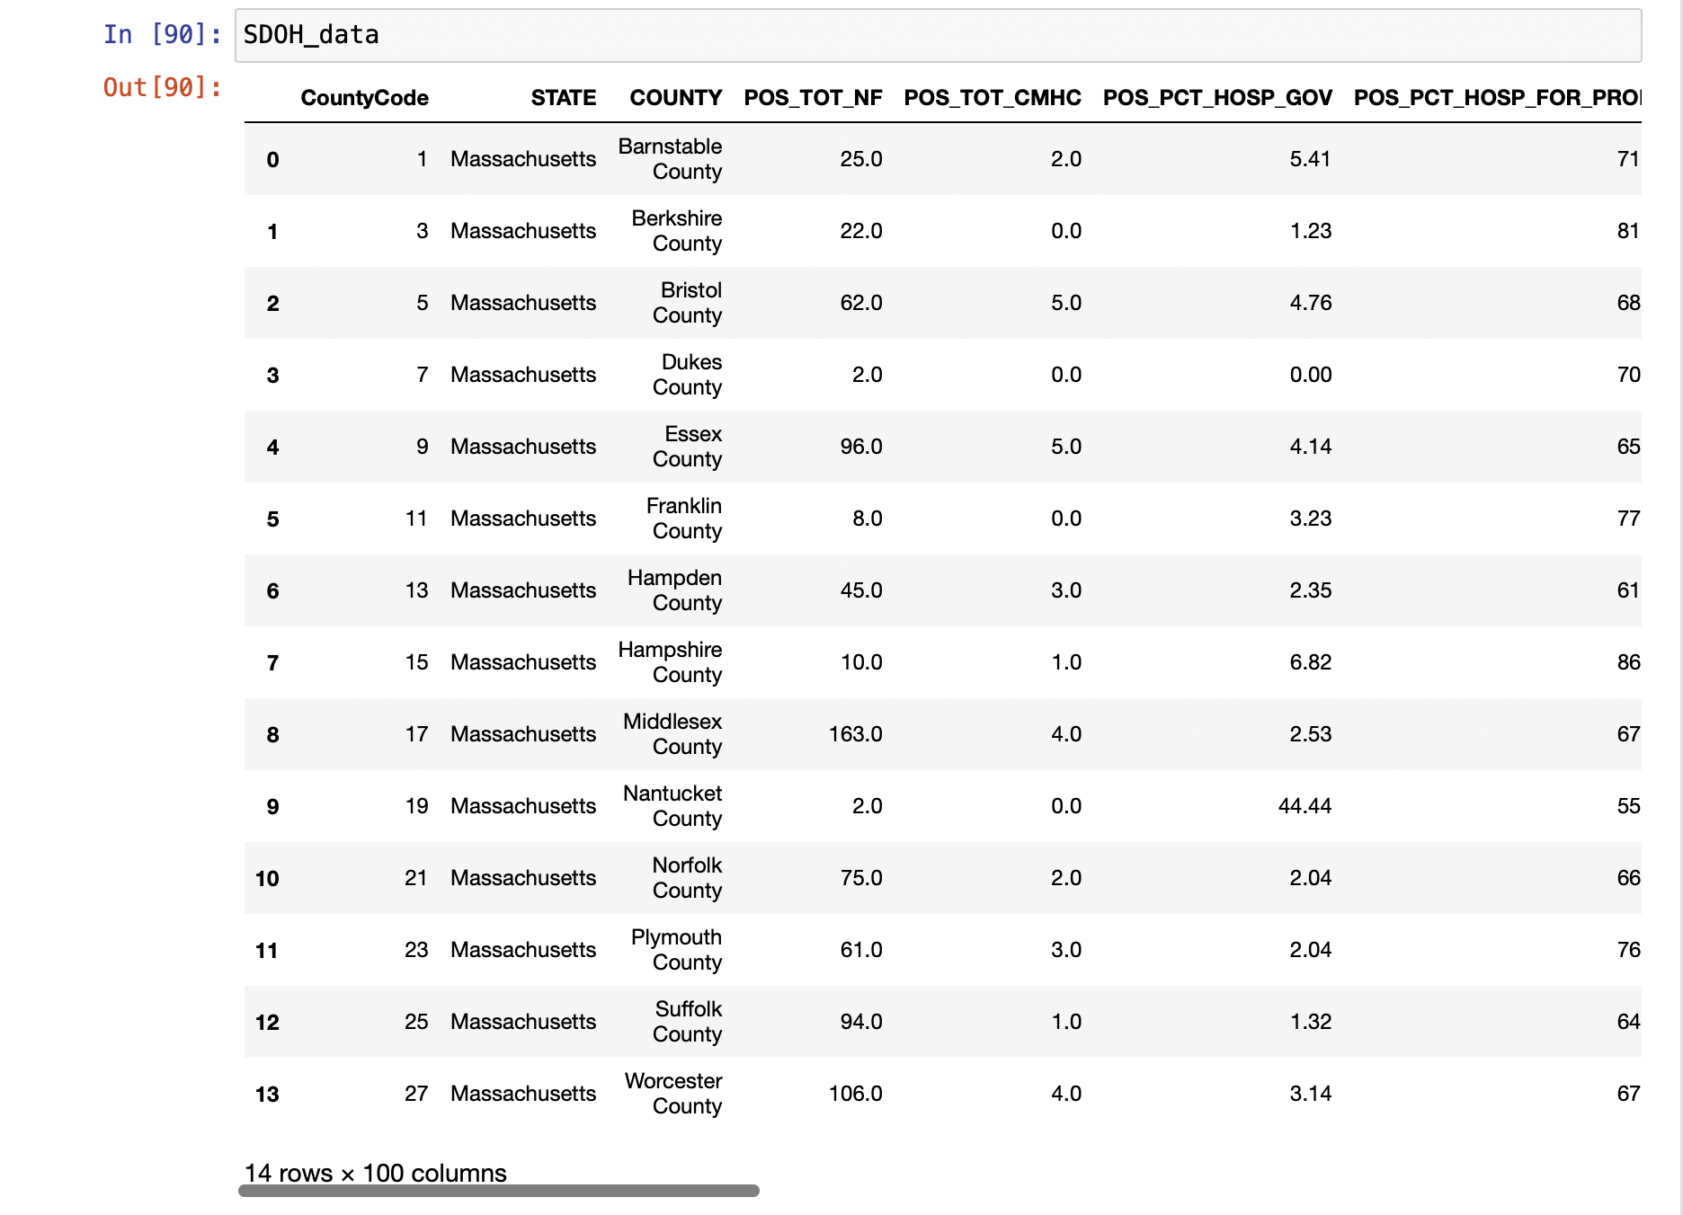
Data Wrangling Steps – FINAL Output Dataset

Slide 9
Data analysis and outcome
Co-relation chart of income and Age group vs murders (crimes As a SDOH)
Table 1: MOST Vulnerable income and AGE group by county
COUNTY NAME | INC<14999 | AGE(30-44)
Barnstable County | 2.92 | 13.22
Berkshire County | 4.34 | 15.79
Bristol County | 4.81 | 18.61
Dukes County | 1.82 | 16.59
Essex County | 4.6 | 18.22
Franklin County | 4.6 | 17.68
Hampden County | 5.94 | 18.03
Hampshire County | 3.97 | 14.78
Middlesex County | 2.97 | 20.88
Nantucket County | 1.48 | 24.5
Norfolk County | 2.9 | 19.2
Plymouth County | 3.19 | 17.07
Suffolk County | 6.01 | 23.47
Worcester County | 4.11 | 18.66
WHAT MORE CAN BE DONE?
Develop regression model factoring all SDOH indices to generate score calculating overall risk level
Repeat the process for other SDOH factors

Slide 10
THANK YOU

